Slide 1


Slide 2
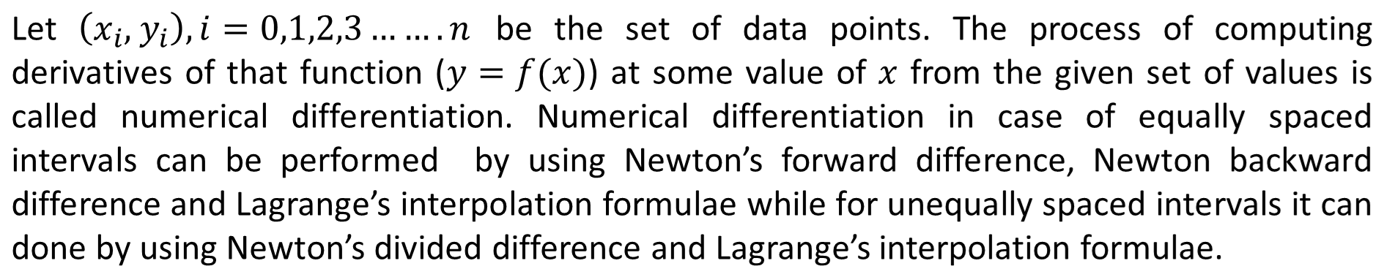

Numerical Differentiation using difference Interpolation formulas
Numerical Methods
National University of Science and Technology, Islamabad

Slide 3
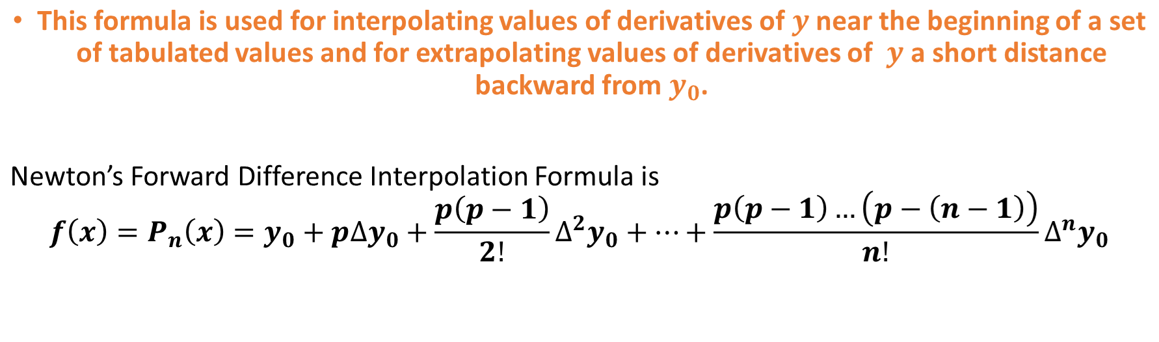
Newton’s Forward Difference Interpolation Formula
Numerical Methods
National University of Science and Technology, Islamabad

Slide 4
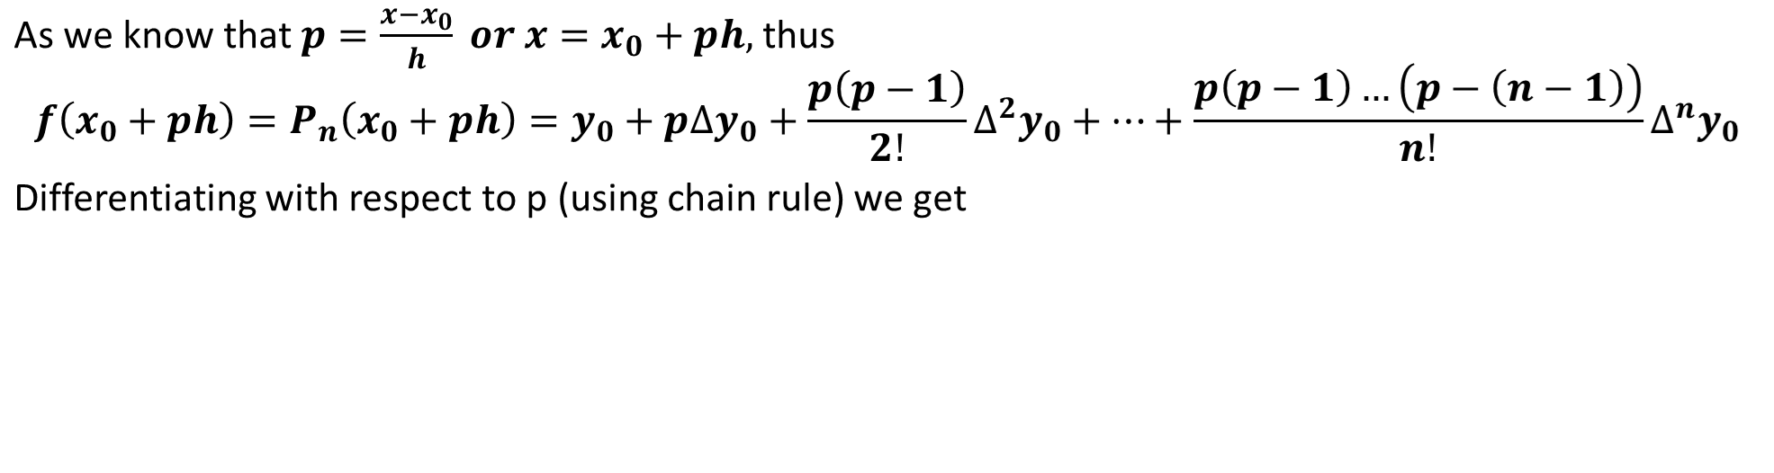
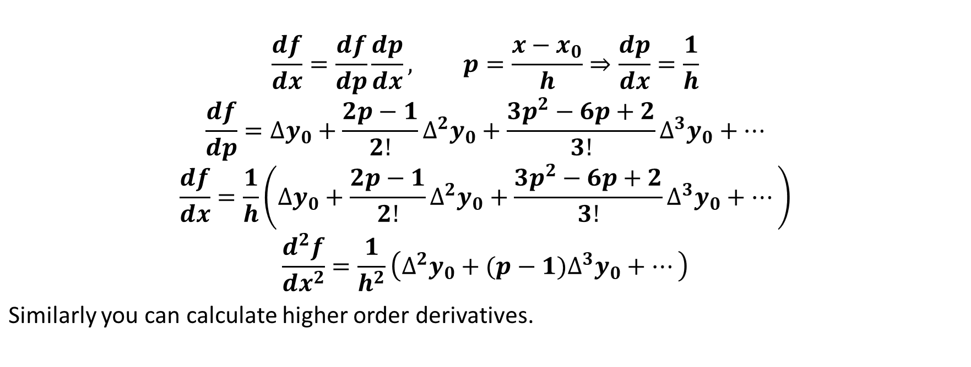
Numerical Methods
National University of Science and Technology, Islamabad

Slide 5
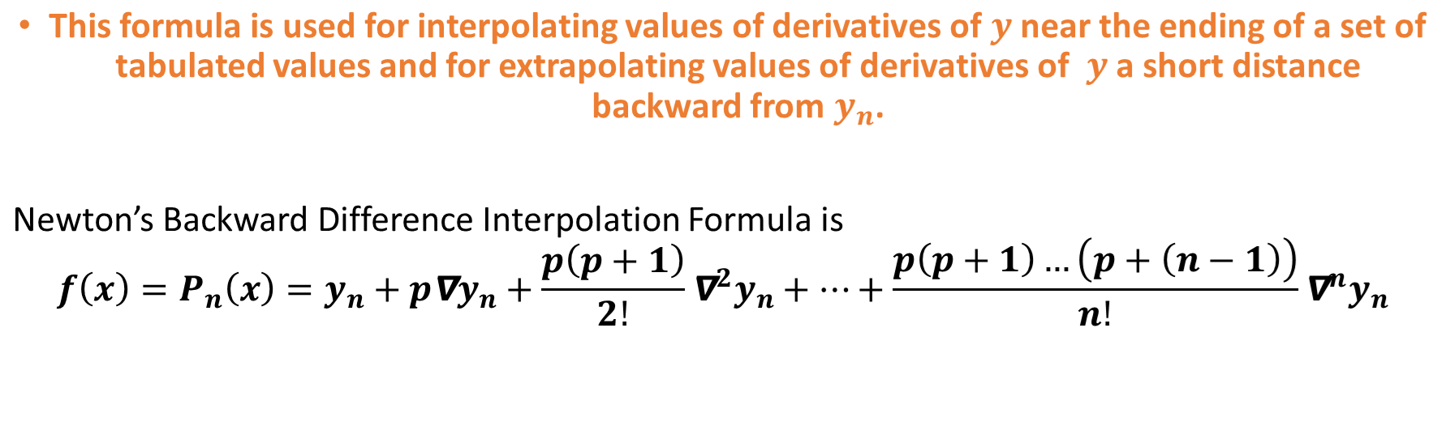
Newton’s backward Difference Interpolation Formula
Numerical Methods
National University of Science and Technology, Islamabad

Slide 6
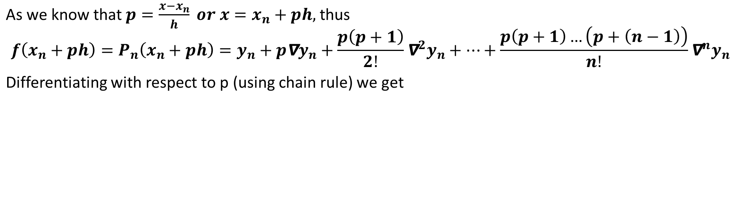
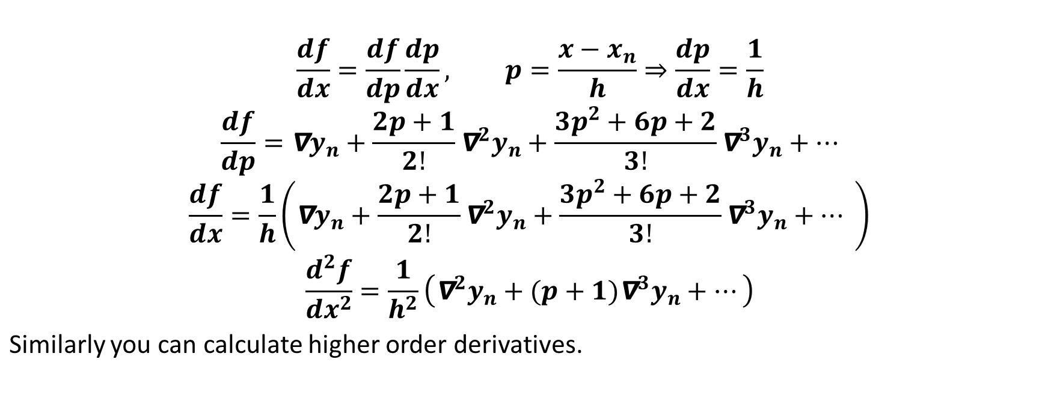
Numerical Methods
National University of Science and Technology, Islamabad

Slide 7
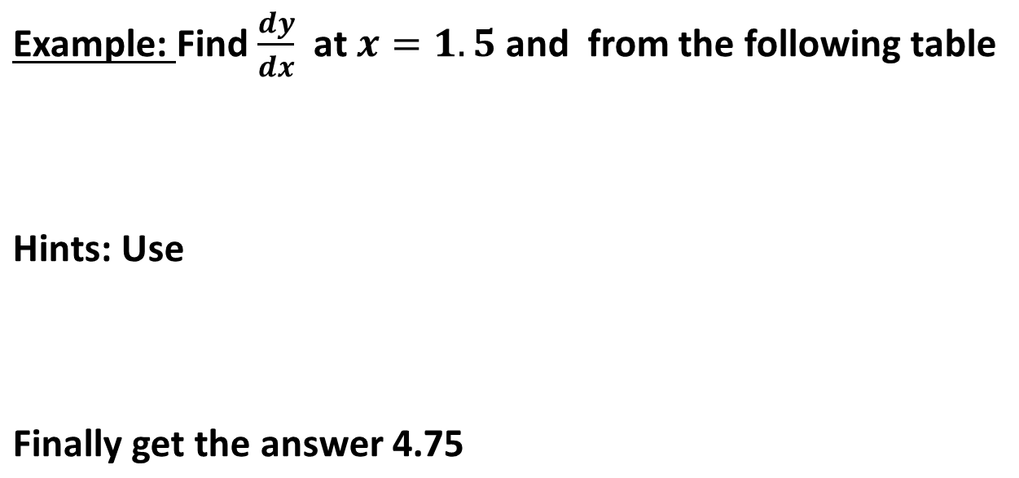
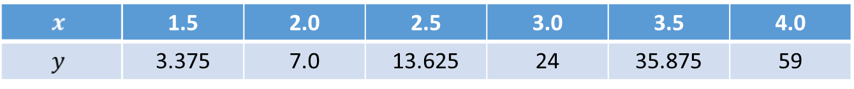
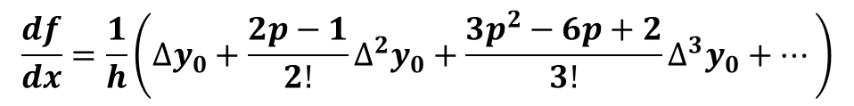
Numerical Methods
National University of Science and Technology, Islamabad

Slide 8
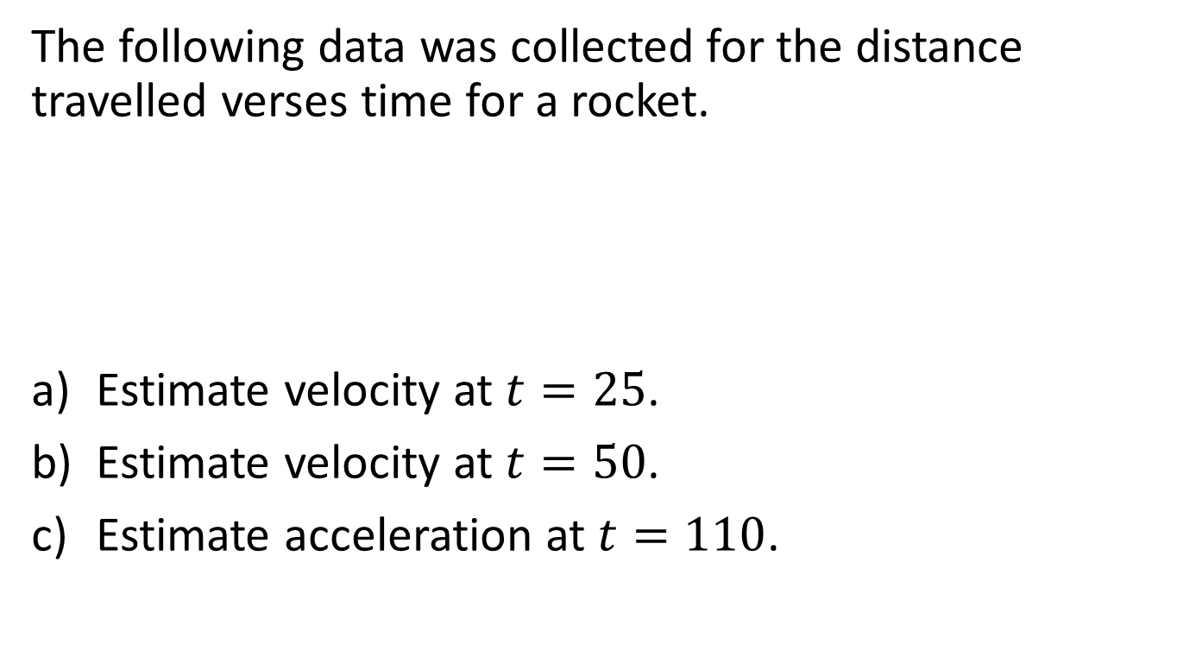
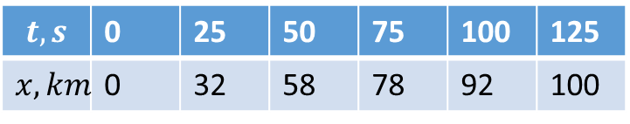
Example 1:

Slide 9
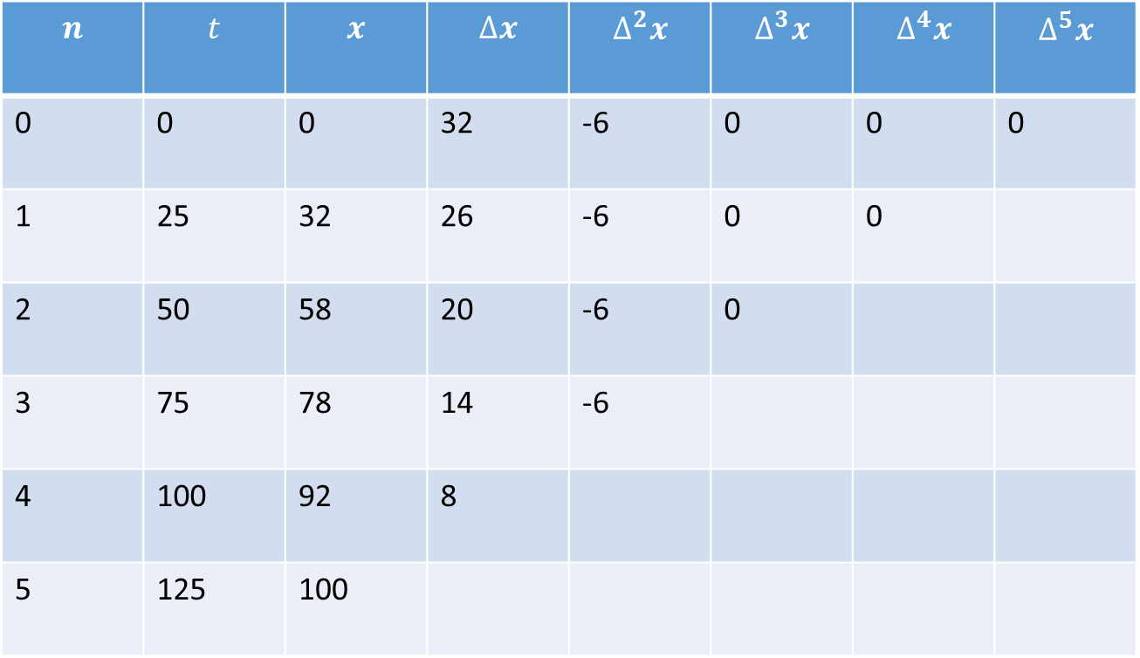

Slide 10
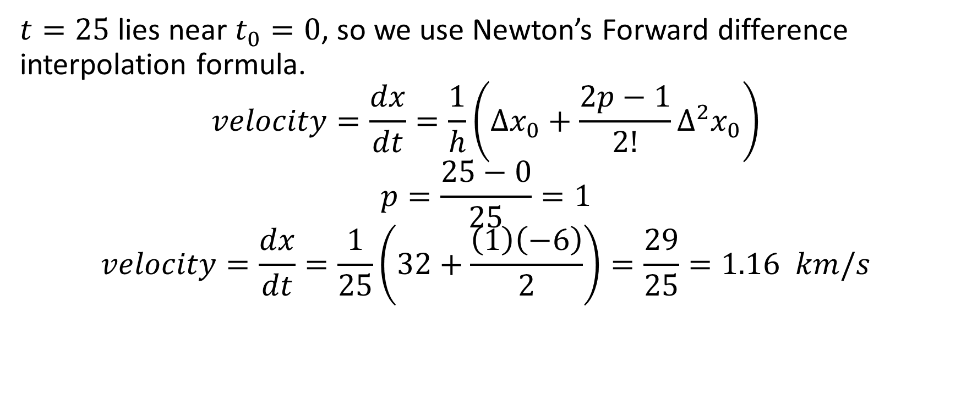
Solution(a)

Slide 11
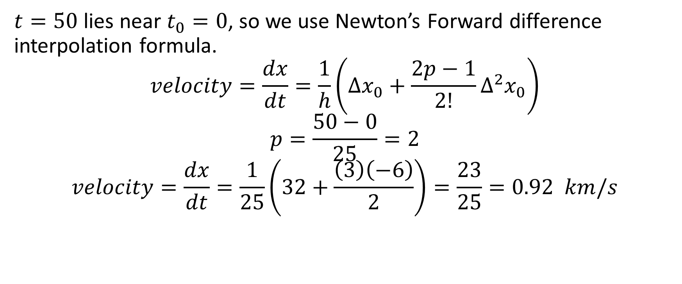
Solution(b)

Slide 12
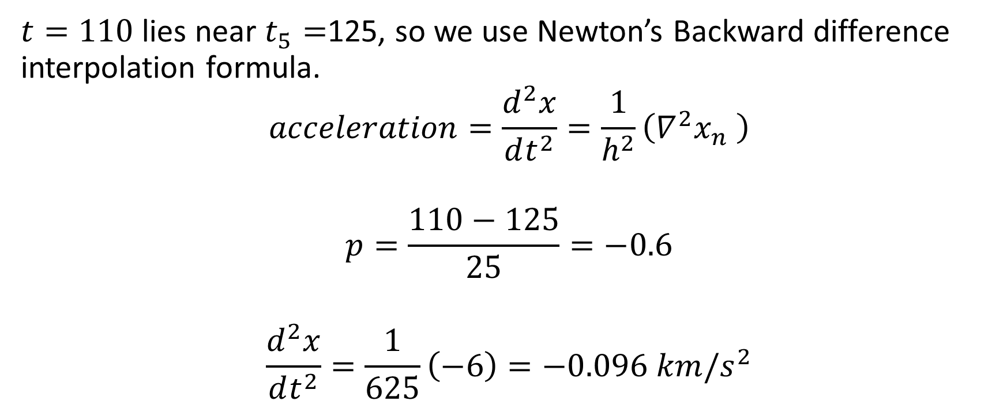
Solution(c)

Slide 13
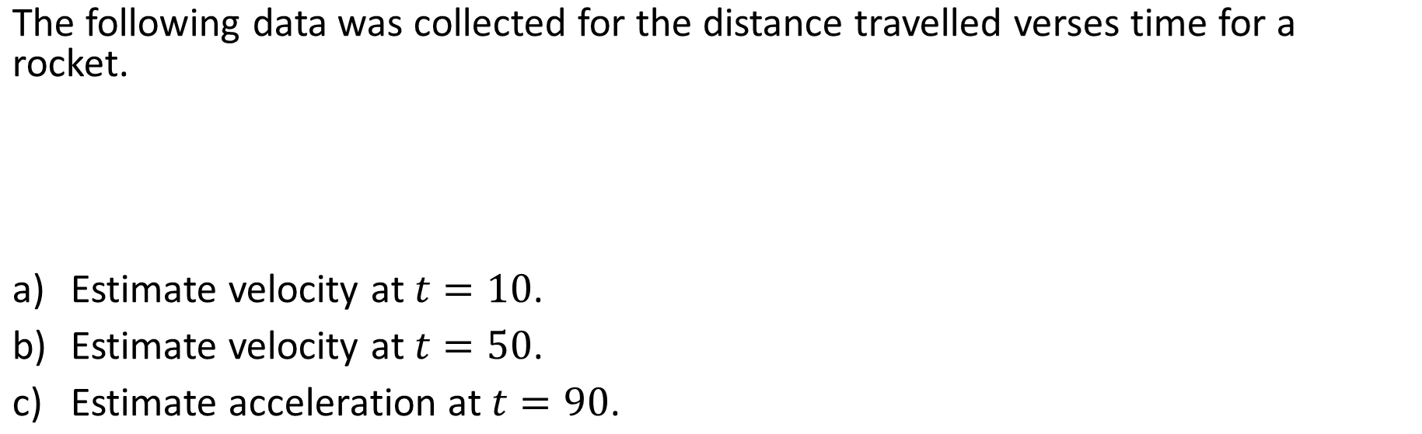
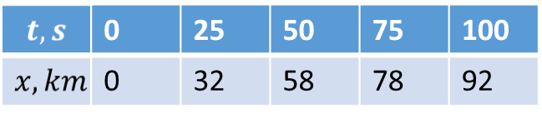
Example 1:
Numerical Methods
National University of Science and Technology, Islamabad

Slide 14
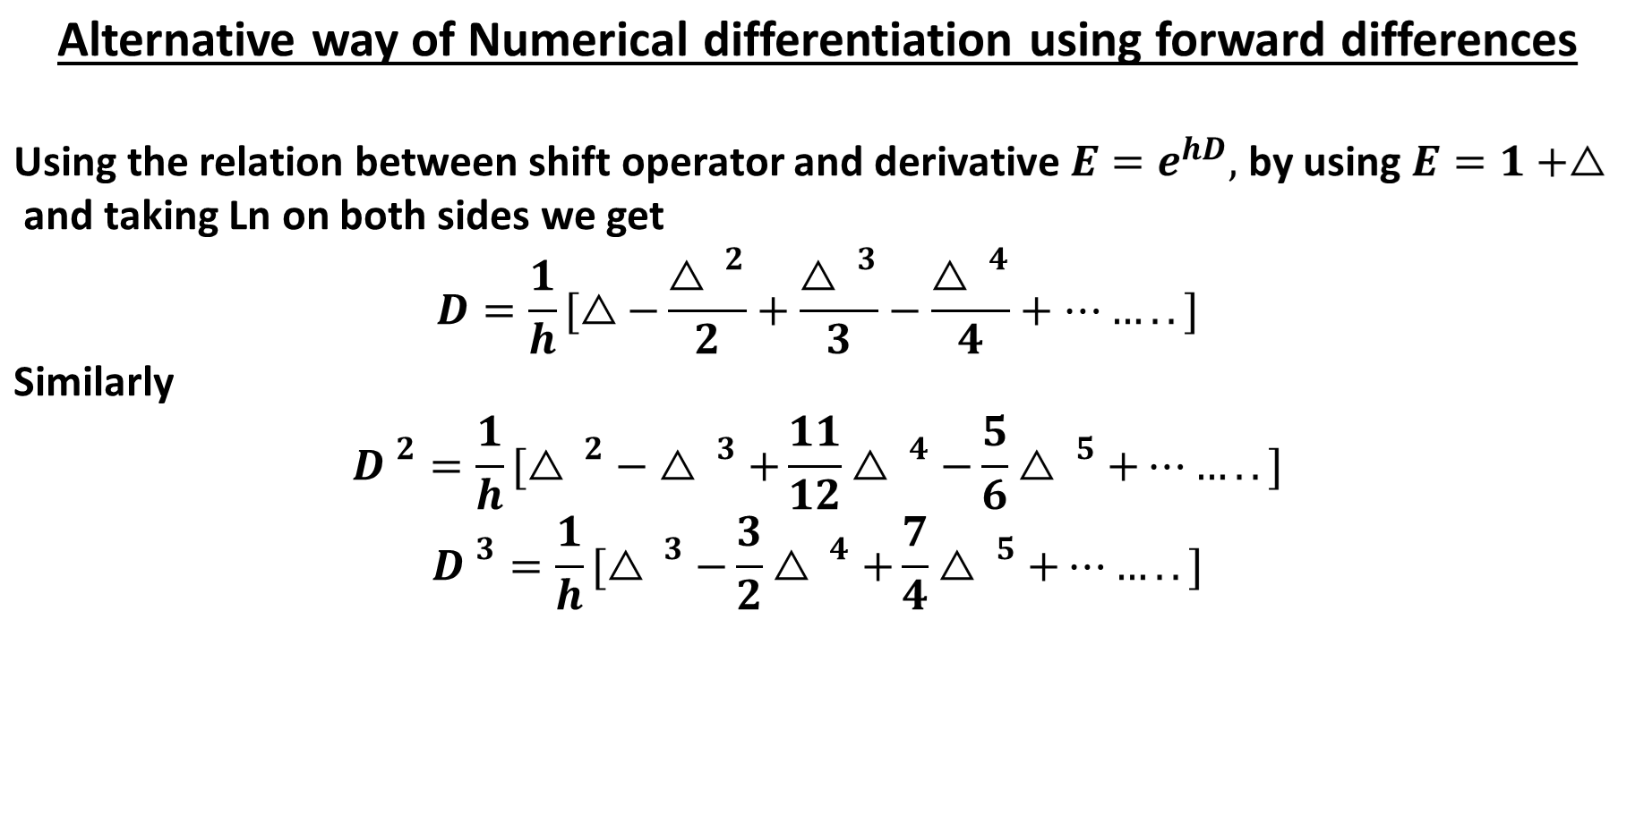
Numerical Methods
National University of Science and Technology, Islamabad

Slide 15
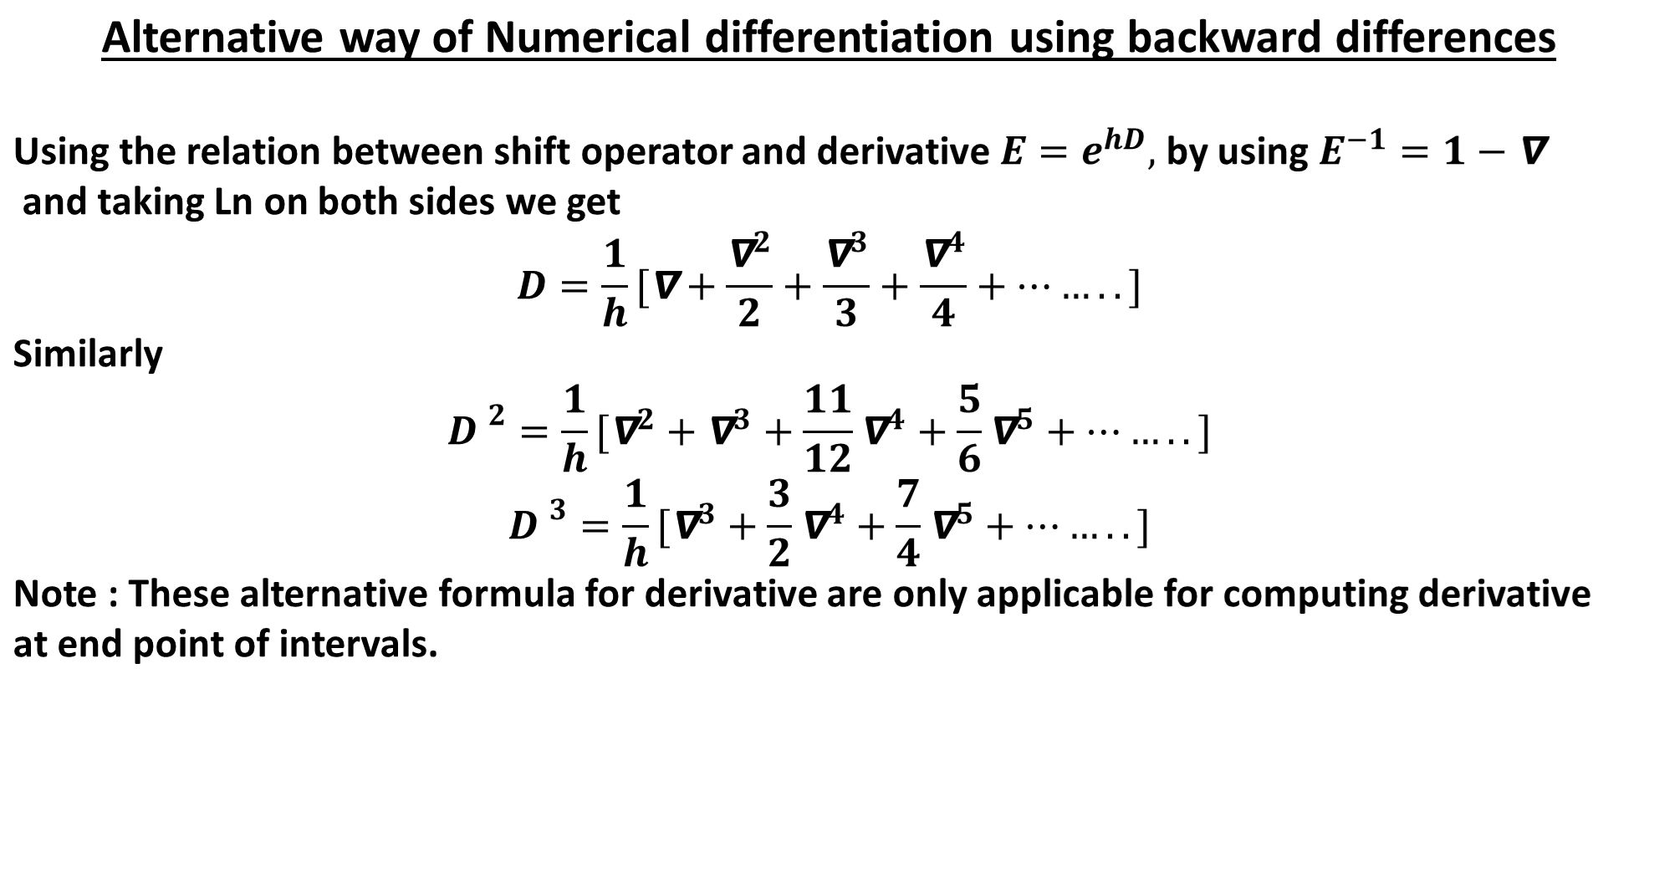
Numerical Methods
National University of Science and Technology, Islamabad

Slide 16
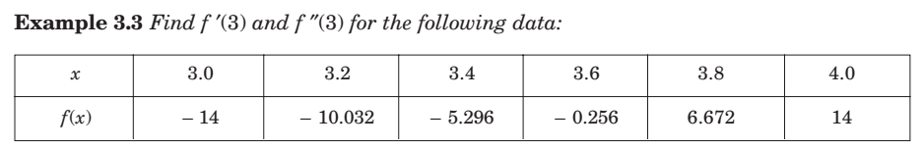
Numerical Methods
National University of Science and Technology, Islamabad

Slide 17
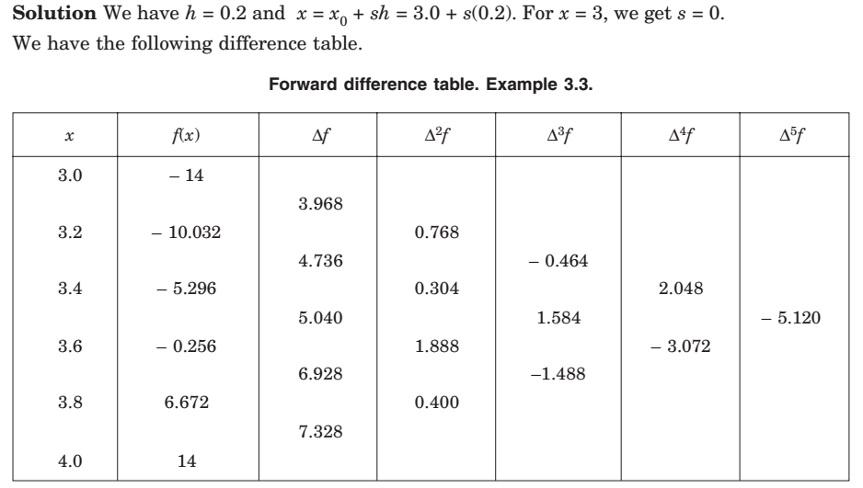
Numerical Methods
National University of Science and Technology, Islamabad

Slide 18
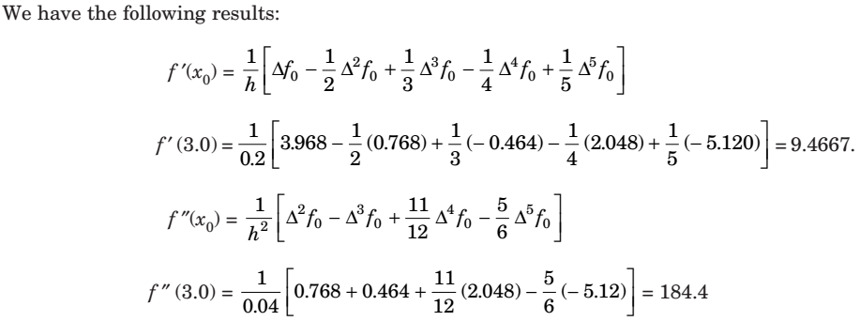
Numerical Methods
National University of Science and Technology, Islamabad

Slide 19
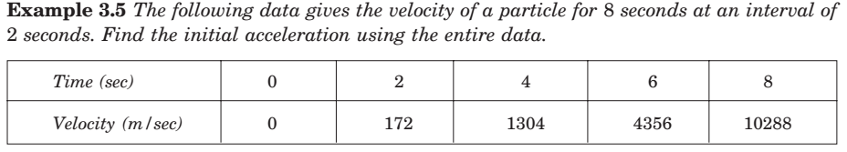
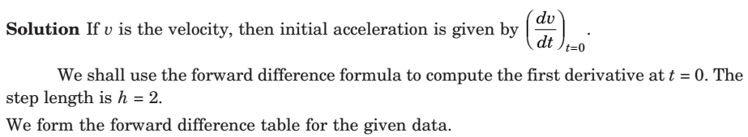
Numerical Methods
National University of Science and Technology, Islamabad

Slide 20
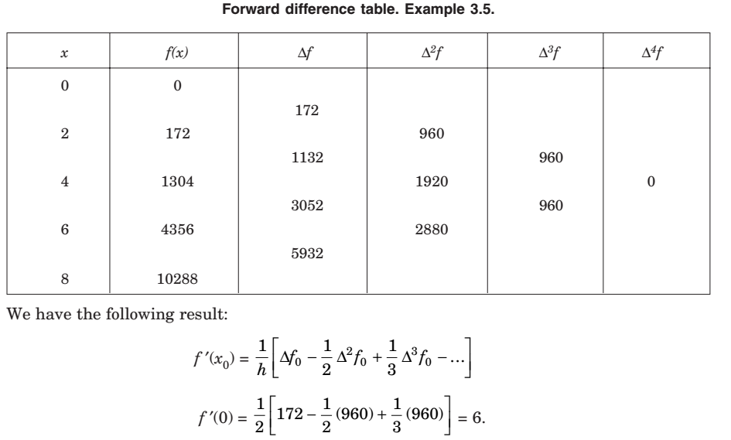
Numerical Methods
National University of Science and Technology, Islamabad

Slide 21
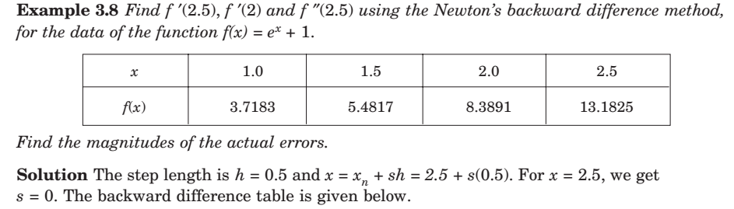
Numerical Methods
National University of Science and Technology, Islamabad

Slide 22
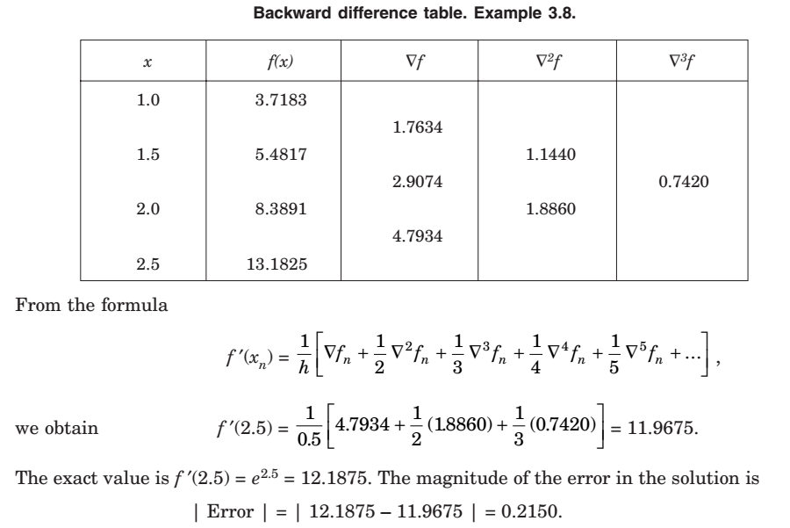
Numerical Methods
National University of Science and Technology, Islamabad

Slide 23
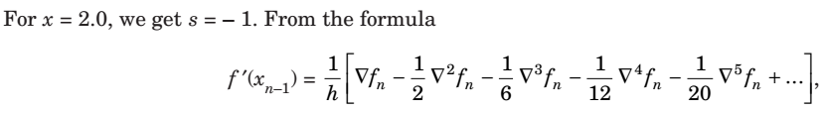
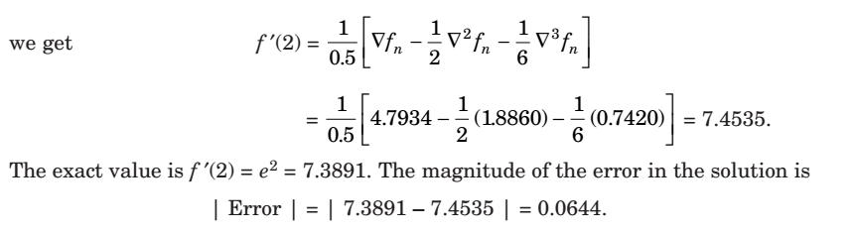
Numerical Methods
Note: This can also be computed by using alternative formula for first order derivative by backward difference table
National University of Science and Technology, Islamabad

Slide 24
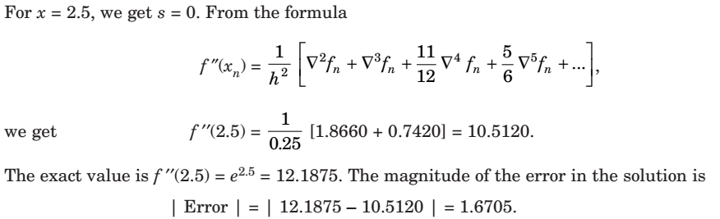
Numerical Methods
National University of Science and Technology, Islamabad

Slide 25
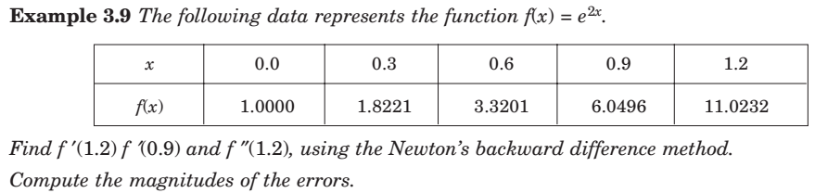
Numerical Methods
National University of Science and Technology, Islamabad

Slide 26
Numerical Methods
Attempt some problems on Numerical differentiation via forward and backward
difference approximations formulae.
National University of Science and Technology, Islamabad

